Slide 1

Database Programming Part II

Slide 2
Stored Procedure
A stored procedure is a set of one or more SQL statements that are stored together in database. To create a stored procedure use CREATE PROCEDURE statement. To use the stored procedure you send a request for it to be executed. When server receives the request, it executes the stored procedure.
Advantage:
Execution plan retention and reuse
Query auto-parameterization
Encapsulation of business rules and policies
Sharing of application logic between applications
Access to database objects that is both secure and uniform
Consistent, safe data modification
Improved security
Reduced development cost and increased reliability
Centralized security, administration, and maintenance for common routines
Notes:
2

Slide 3
Stored Procedure
Syntax:
CREATE PROCEDURE <procedure_name>
[@parameter1 data_type, @parameter2 data_type…] AS BEGIN /* SQL Statements. */ END
GO
Example:
CREATE PROCEDURE usp_SelectAllEmployee
AS
BEGIN
SELECT * FROM Employee
END
GO
Notes:
3

Slide 4
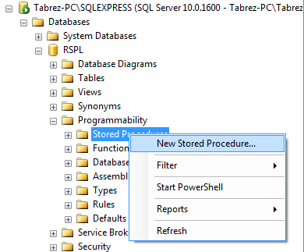
Stored Procedure
How to create Stored Procedure?
To create stored procedure right click on ‘Stored Procedure’ folder under ‘Programmability’ folder and choose ‘New Stored Procedure…’ option as shown in above figure.
Notes:
4

Slide 5
View
In SQL, a view is a virtual table based on the result-set of an SQL statement.
A view contains rows and columns, just like a real table. The fields in a view are fields from one or more real tables in the database.
You can add SQL functions, WHERE, and JOIN statements to a view and present the data as if the data were coming from one single table.
Syntax:
CREATE [OR REPLACE] VIEW view_name AS SELECT column_name(s) FROM table_name WHERE condition
Example:
CREATE VIEW [Employee_List] AS SELECT EmployeeID,FirstName,LastName FROM Employee WHERE Salary > 5000
We can query the view above as follows:
SELECT * FROM [Employee_List]
Notes:
5

Slide 6
View
Advantages:
View the data without storing the data into the object.
Restrict the view of a table i.e can hide some of columns in the tables.
Join two or more tables and show it as one to user.
Restrict the access of a table so that nobody can insert the rows into the table.
Disadvantages:
1. Can not use DML operations on this.
2. When the table is dropped view becomes inactive.
3. It is an object so it occupies space.
4. Order by will not work.
5. View over view not allow.
6. Adding new columns in table doesn't effect to view.

Slide 7
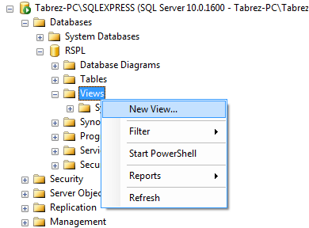
How to create view?
Step 1:
To create view right click on ‘Views’ folder under database and choose ‘New View…’ option as shown in above figure.
Notes:
7

Slide 8
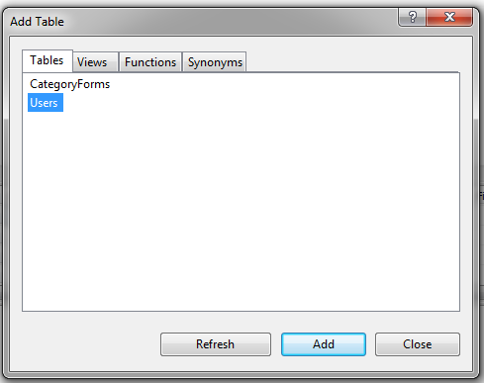
How to create view?
Step 2:
Once you click on ‘New View…’ option you will have a dialogbox with list of Tables, choose table for which you want to create view and add it in query builder by click on Add button and close it as shown in above figure.
Notes:
8

Slide 9
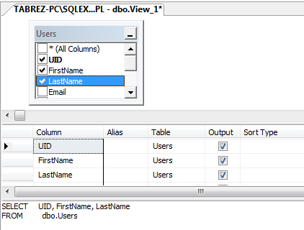
How to create view?
Step 3:
Once you close ‘Add Table’ dialog box you will see your selected table added in query builder, corresponding query in SQL Pane (i.e. last row) and you can update it as shown in above figure.
After creating query to save view press Ctrl+S and give view name and save it you will see created view under ‘View’ folder.
Notes:
9

Slide 10
User-Defined Function
A user-defined function is a Transact-SQL or common language runtime (CLR) routine that accepts parameters, performs an action, such as a complex calculation, and returns the result of that action as a value. The return value can either be a scalar (single) value or a table.
Advantages:
It permits calculations that are too complex, awkward, or unavailable with SQL.
UDF can be used in a Select, Where or Case statement.
UDF can be used to create joins.
Simple to invoke from inside another SQL statement.
Disadvantages:
1. UDF cannot be used to modify base table information. The DML statement INSERT, UPDATE and DELETE can;t be used on base tables.
2. SQL function that return non-deterministic values are not allowed to be called from inside UDF.

Slide 11
User-Defined Function
Types of UDF:
Scalar function
Return a single value.
In Line Table function
Return a single table variable that was created by a select statement.
Multi-statement Table function
Returns a table variable whose structure was created by hand, similar to a Create Table statement.
Notes:
11

Slide 12
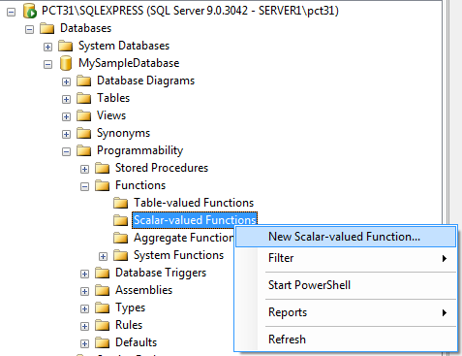
Type of UDF
1. Scalar Function
To add new scalar function right click on 'Scalar-valued Functions' under 'Functions' folder and choose 'New Scalar-valued Function...' option as shown in above figure. You will see the scalar function's syntax in SQL pane beside object explorer, update it as per need and save it by pressing Ctrl+S and give function name when ask to save.
Notes:
12

Slide 13
Type of UDF
1. Scalar Function
Example:
CREATE FUNCTION dbo.DateOnly(@InDateTime datetime)
RETURNS varchar(10)
AS
BEGIN
DECLARE @MyOutput varchar(10)
SET @MyOutput = CONVERT(varchar(10),@InDateTime,101)
RETURN @MyOutput
END
To call function:
SELECT dbo.DateOnly(GETDATE())
Above function takes full date and time as parameter and returns only date in varchar datatype.
Notes:
13

Slide 14
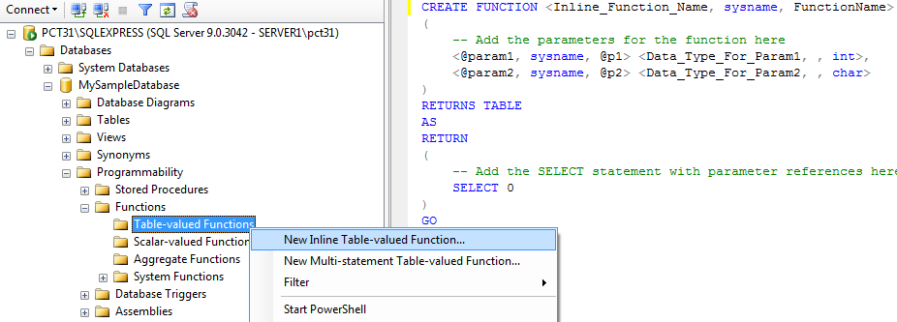
Type of UDF
2. In-line Table Function
To add new In-line Table function right click on 'Table-valued Functions' under 'Functions' folder and choose 'New Inline Table-valued Function...' option as shown in above figure. You will see the Inline function's syntax in SQL pane beside object explorer, update it as per need and save. You will see the created function under 'Table-valued Functions' folder.
Notes:
14

Slide 15
Type of UDF
2. Inline Table Function
Example:
CREATE FUNCTION dbo.LookByFName(@FirstLetter char(1))
RETURNS TABLE
AS
RETURN
(SELECT *
FROM employee
WHERE LEFT(fname, 1) = @FirstLetter)
To call function:
SELECT * FROM dbo.LookByFName('A')
Above function returns all the employee whose first name start with a character 'A'.
Notes:
15

Slide 16
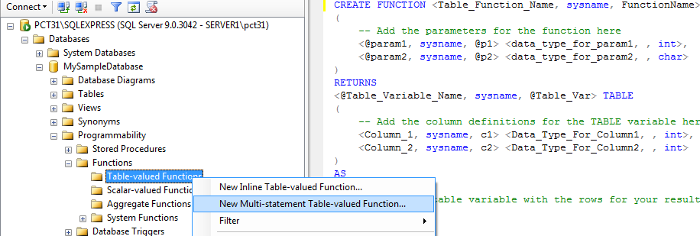
Type of UDF
3. Multi-Statement Table Function
To add new multi-statement Table function right click on 'Table-valued Functions' under 'Functions' folder and choose 'New Multi-statement Table-valued Function...' option as shown in above figure. You will see the function's syntax in SQL pane beside object explorer, update it as per need and save. You will see the created function under 'Table-valued Functions' folder.
Notes:
16

Slide 17
Type of UDF
3. Multi-statement Table Function
Example:
CREATE FUNCTION dbo.multi_test(@FirstLetter char(1))
RETURNS @Result TABLE
(fname varchar(20), hire_date datetime,on_probation char(1))
AS
BEGIN
INSERT INTO @Result (fname, hire_date)
SELECT fname, hire_date FROM employee
WHERE LEFT(fname, 1) = @FirstLetter
UPDATE @Result SET on_probation = 'N'
UPDATE @Result SET on_probation = 'Y' WHERE hire_date < '01/01/1991'
RETURN
END
To call function:
SELECT * FROM dbo.multi_test('A')
Notes:
17

Slide 18
UDF V/S Stored Procedure
Function | Stored Procedure
UDF are simpler to invoke than Stored Procedures from inside another SQL statement. | 1. They are Complex to Invoke.
2. Function return type could be scalar or table or table values(SQL Server). | 2. It returns always integer value by default zero.
3. The User Defined Function must be prefaced with the owner name. | 3.DBO in this case. Not mandatory.

Slide 19
UDF V/S Stored Procedure
Function | Stored Procedure
4. A UDF is always used to return a value or a table object. | 4. You can also get values back from a stored procedure by the return code (integer only) or an output parameter.
5. Functions are not precompiled. | 5. It is pre compiled execution plan.
6. Function returns only one value at a time. | 6. It returns more than one value at a time.
7. We can call the functions in SQL statements (select max(sal) from emp). | 7.We cannot call Stored Procedures in SQL Statements.
8. Function parameters are always IN, no OUT is possible. Output parameters must be returned as return values. | 8.Stored procedures can have input and output parameters.

Slide 20
Cursor
1. A Cursor is a database object that represents a result set and is used to manipulate data row by row.
2. When a cursor is opened, it is positioned on a row and that row is available for processing.
3. SQL Server supports four types of cursor as bellow:
(I) Static
A static cursor populates the result set at the time of cursor creation and query result is cached for the lifetime of the cursor. A static cursor can move forward and backward direction. A static cursor is slower and use more memory in comparison to other cursor. Hence you should use it only if scrolling is required and other types of cursors are not suitable.
(ii) Dynamic cursor.
A dynamic cursor allows you to see the data updation, deletion and insertion in the data source while the cursor is open. Hence a dynamic cursor is sensitive to any changes to the data source and supports update, delete operations. By default dynamic cursors are scrollable.

Slide 21
Cursor
(iii) Forward-only
A forward only cursor is the fastest cursor among the all cursors but it doesn't support backward scrolling. You can update, delete data using Forward Only cursor. It is sensitive to any changes to the original data source.
(iv) Key set
A keyset driven cursor is controlled by a set of unique identifiers as the keys in the keyset. The keyset depends on all the rows that qualified the SELECT statement at the time of cursor was opened. A keyset driven cursor is sensitive to any changes to the data source and supports update, delete operations. By default keyset driven cursors are scrollable.

Slide 22
Cursor
Syntax:
DECLARE CursorName CURSOR READ_ONLY FORWARD_ONLY LOCAL FOR SELECT ColumnName FROM TableName OPEN CursorName FETCH NEXT FROM CursorName INTO @Variable WHILE @@FETCH_STATUS <> -1 BEGIN <Your part of code for the success condition> FETCH NEXT FROM CursorName INTO @Variable END CLOSE CursorName DEALLOCATE CursorName
(Note: Cursor can be created in stored procedure)
Notes:
22

Slide 23
Cursor
Example:
/* Create two variables that would store the values returned by the fetch statement */
DECLARE @DepartmentName char(25) DECLARE @DepartmentHead char(25) /* Define the cursor that can be used to access the records of the table,row by row */
DECLARE curDepartment cursor for SELECT vDepartmentName,vDepartmentHead from Department -- Open the cursor
OPEN curDepartment -- Fetch the rows into variables
FETCH curDepartment into @DepartmentName,@DepartmentHead
(Continue...)
Notes:
23

Slide 24
Cursor
Example:
--Start a loop to display all the rows of the cursor WHILE(@@fetch_status=0) BEGIN Print 'Department Name =' + @DepartmentName Print 'Department Head =' + @DepartmentHead --Fetch the next row from the cursor FETCH curDepartment into @DepartmentName,@DepartmentHead END -- Close the cursor CLOSE curDepartment -- Deallocate the cursor DEALLOCATE curDepartment
Notes:
24

Slide 25
Cursor
Advantages of Cursors: 1. Row by Row operations can be successfully executed. Disadvantages of Cursors: 1. SQL Server by default have a direct performance degradation on the usage of cursors. SQL Server Engine processes records or data in such a way it will have a performance impact when cursor is used. 2. As you add overhead to the Server / engine, it will eat up your memory and hence other parallel processes will suffer too. 3. Cursors are the SLOWEST way to access data inside SQL Server as it does row by row operations and cursors are over thirty times slower than set based alternatives.
Considerations before using a Cursor: 1. Think of all possible alternatives to solve your problem and if you didnt got any then create a cursor. 2. Consider Temp tables as alternatives to usage of cursors.

Slide 26
Triggers
Types of Triggers
In SQL Server we can create the following 3 types of triggers:
Logon triggers
Data Definition Language (DDL) triggers
Data Manipulation Language (DML) triggers
After Triggers (For Triggers)
Instead Of Triggers
Logon trigger
This type of trigger is fired against a LOGON event before a user session is established to the SQL Server.
DDL Triggers
In SQL Server we can create triggers on DDL statements (like CREATE, ALTER and DROP) and certain system-defined Stored Procedures that does DDL-like operations.

Slide 27
Triggers
DML Triggers
In SQL Server we can create triggers on DML statements (like INSERT, UPDATE and DELETE) and Stored Procedures that do DML-like operations. DML Triggers are of two types.

Slide 28
Index
An index in SQL Server assists the database engine with locating records, just like index in book helps you locate information quickly. Indexes are structured to facilitate the rapid return of result sets. The characteristics of an index affect its use of system resources and its lookup performance. The query optimizer uses an index if it will increase query performance. The use of indexes is necessary as without indexes, a query causes SQL Server to search all records in a table (table scan) in order to find matches. Therefore, proper usage of indexes is of prime importance from performance point of view.
Types of Indexes:
1. Clustered Index
2. Non-clustered Index

Slide 29
Index
1. Clustered Index
Clustered indexes define the physical sorting of a database table’s rows in the storage media. For this reason, each database table may have only one clustered index. If a PRIMARY KEY constraint is created for a database table and no clustered index currently exists for that table, SQL Server automatically creates a clustered index on the primary key.
2. Non-clustered Index
Non-clustered indexes are created outside of the database table and contain a sorted list of references to the table itself. SQL Server 2000+ supports a maximum of 249 non-clustered indexes per table. However, it’s important to keep in mind that non-clustered indexes slow down the data modification and insertion process, so indexes should be kept to a minimum.

Slide 30
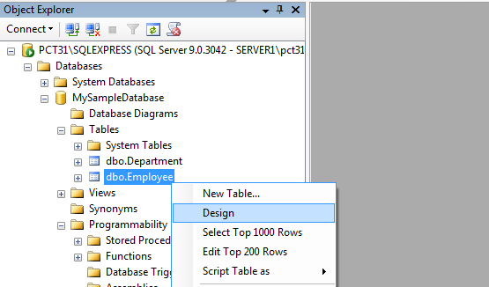
To Create an Index
Step 1. From object explorer, right click on the table name(e.g Employee here) and click on design option as shown in below figure. Once you choose Design option a table design window will be open beside of Object Explorer.

Slide 31
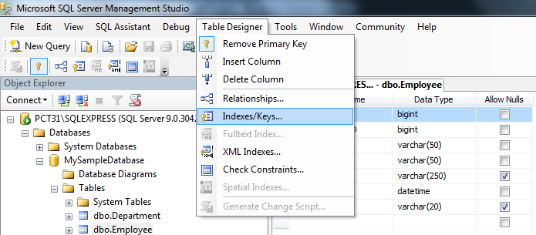
To Create an Index
Step 2. Click on 'Index/Keys' from 'Table Designer' menu on top or right click on any column and click on 'Index/Keys' as shown in below figure.

Slide 32
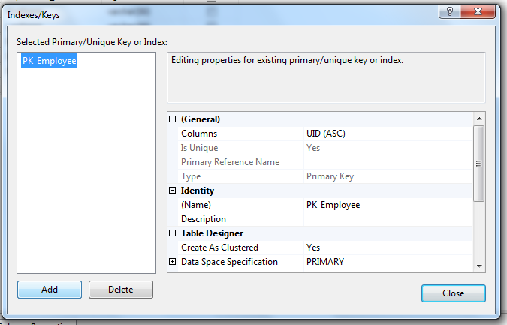
To Create an Index
Step 3. Click on 'Add' from Indexes/Keys dialog box.

Slide 33
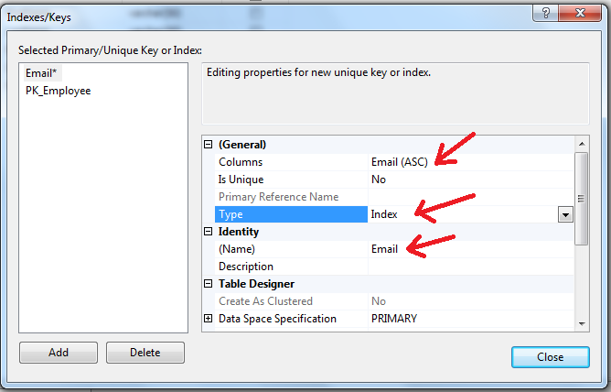
To Create an Index
Step 4. From selected Primary/Unique key or Index list, select the new index and set properties for the index in the grid on right hand side.
Step 5. Now just specify other settings if any for the index and click Close. Step 6. When we save the table, the index is created in the database.

Slide 34
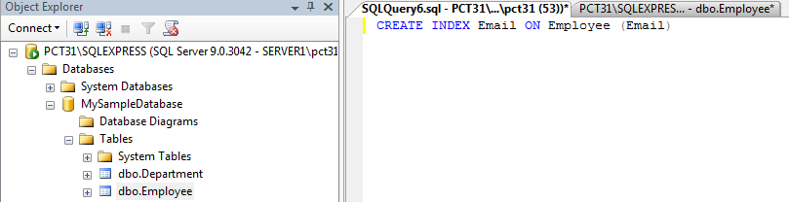
To Create an Index
We also create this index by using query as shown in below screen shot.
Syntax:
CREATE INDEX index_name ON table_name (column_name)
Note: In above example shows that index is created on Email field on Employee table.

Slide 35
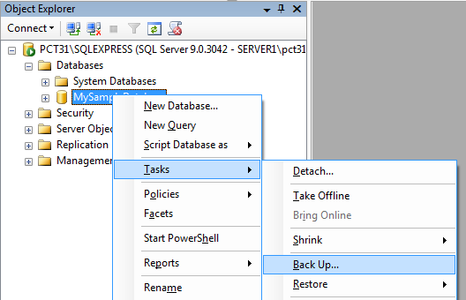
Back Up a Database
To back up a database follow bellow list of steps:
Step 1: After connecting to the appropriate instance of the Microsoft SQL Server Database Engine, in Object Explorer, click the server name to expand the server tree.
Step 2: Right-click the database, point to Tasks, and then click Back Up. The Back Up Database dialog box appears as shown in below figure.

Slide 36
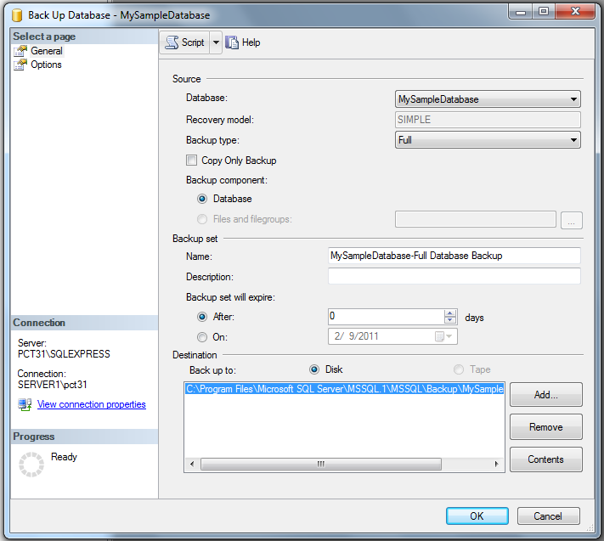
Back Up a Database

Slide 37
Back Up a Database
Step 3: In the Database list box, verify the database name. You can optionally select a different database from the list.
Step 4: In the Backup type list box, select Full.
Step 5: For Backup component, click Database.
Step 6: Either accept the default backup set name suggested in the Name text box, or enter a different name for the backup set.
Step 7: Optionally, in the Description text box, enter a description of the backup set.
Step 8: Choose 'Disk' the type of backup destination.
Step 9: The default database back up destination path suggested in list box, but you can change it by adding new destination path by click on 'Add...' button browse and choose new path.
Step 10: Now select appropriate destination path from list and click on OK button. After that go to specified path you will find created database back up file with .bak extension.

Slide 38
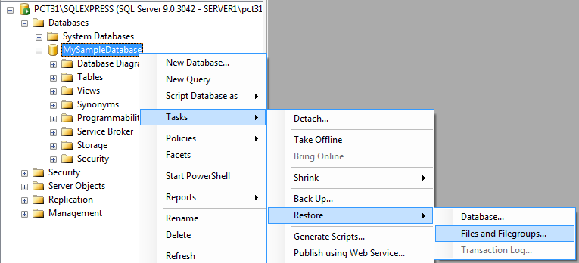
Restore a Database Backup
To restore a database backup follow bellow list of steps:
Step 1: After connecting to the appropriate instance of the Microsoft SQL Server Database Engine, in Object Explorer, click the server name to expand the server tree.
Step 2: As shown in below figure right-click the database, point to Tasks > Restore, and then click Files and Filegroups. The Restore Database dialog box will be appears.

Slide 39
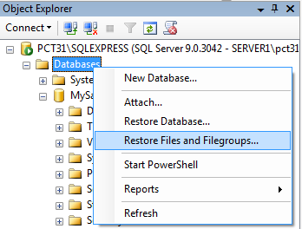
Restore a Database Backup
(OR)
Step 2: As shown in below figure right-click the Databases, and then click 'Restore Files and Filegroups...'. The Restore Database dialog box will be appears.

Slide 40
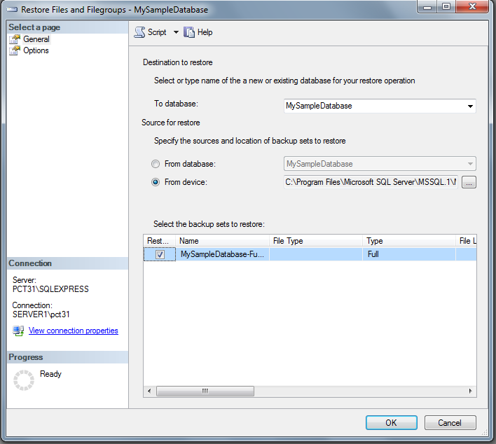
Restore a Database Backup

Slide 41
Restore a Database Backup
Step 3: On the General page, the name of the restoring database appears in the To database list box. To create a new database, enter its name in the list box manually.
Step 4: Choose 'From device' in source for restore.
(Note: From database option use when you want to restore a database from one of existing database)
Step 5: Click the browse button, which opens the Specify Backup dialog box. In the Backup media list box, select one of the listed device types. To select one or more devices for the Backup location list box, click Add. After you add the devices you want to the Backup location list box, click OK to return to the General page.
Step 6: In the Select the backup sets to restore grid, select the backups to restore. This grid displays the backups available for the specified location.
Step 7: To view or select the advanced options, click Options in the Select a page pane.

Slide 42
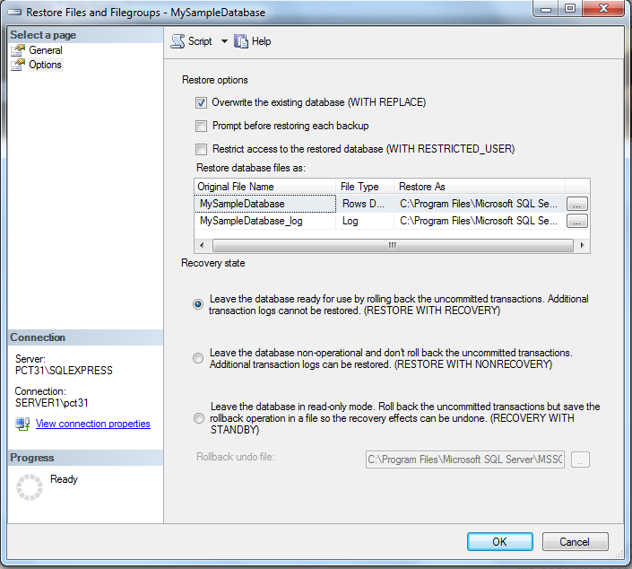
Restore a Database Backup

Slide 43
Restore a Database Backup
Step 8: In the Restore options panel, choose 'Overwrite the existing database' option as shown in above figure.
Step 9: Optionally, you can restore the database to a new location by specifying a new restore destination for each file in the Restore the database files as grid.
Step 10: Choose 'Restore with Recovery' option in Recovery state,if by default not selected.
Step 11: Click on OK button to finish restore database.

Slide 44
Reference link
1. Database, Table, Sql Statement,View
1. http://www.cl500.net/index.html
2. http://blog.sqlauthority.com/best_top_sql_server_blog_all_post/
3. http://msdn.microsoft.com/en-us/library/ms186312.aspx
4. http://www.mrbool.com/articles/viewcomp.asp?comp=4672
5. http://www.globalguideline.com/sql/What_Is_SQL_Table.php
6. http://www.w3schools.com/sql/sql_select.asp
2. Function
1.http://chiragrdarji.wordpress.com/2007/04/17/
difference-between-user-defined-function-and-stored-procedure/
2. http://www.dotnetspider.com/resources/
19189-Difference-Chart-User-Defined-Function-UDF.aspx
3. Cursor
1. http://msdn.microsoft.com/en-us/library/ms191179.aspx
4. Index
1. http://www.dotnetspark.com/kb/1957-indexex-sql-server.aspx
2. http://www.codeproject.com/KB/database/Define_Index_in_SQLServer.aspx
Notes:
44

Slide 45
Reference link
5. Join
1. http://programming.top54u.com/post/Types-of-Joins-in-Sql-Server-2005.aspx
6. Back Up Database
1. http://msdn.microsoft.com/en-us/library/ms187510.aspx
7. Restore a Database
1. http://msdn.microsoft.com/en-us/library/ms177429.aspx
8 Triggers
https://www.c-sharpcorner.com/UploadFile/a53f1a/triggers-in-sql-server/
https://www.codeproject.com/Articles/25600/Triggers-SQL-Server
https://docs.microsoft.com/en-us/sql/relational-databases/triggers/ddl-triggers?view=sql-server-2017
https://docs.microsoft.com/en-us/sql/relational-databases/triggers/logon-triggers?view=sql-server-2017
Notes:
45

Slide 46
Advance Database Programming
THANK YOU
ANY QUESTIONS ?
Notes:
46
46

